Slide 1
Visualising Data
Why do we use BI software?

Slide 2
1. Visuals
3. Tools
6. Priorities
5. Visual best practices
2. Dashboards
4. Storytelling
Lesson agenda

Slide 3
Data visualisations are:
Graphical representations of data or information in a visual format.
Visual elements such as charts, graphs, maps, and diagrams created to present data patterns
Allows you to detect relationships, observe trends, gaps, and opportunities more intuitively
Notes:
class discussion –ask the learners first for their list (gather on the class whiteboard)

Slide 4
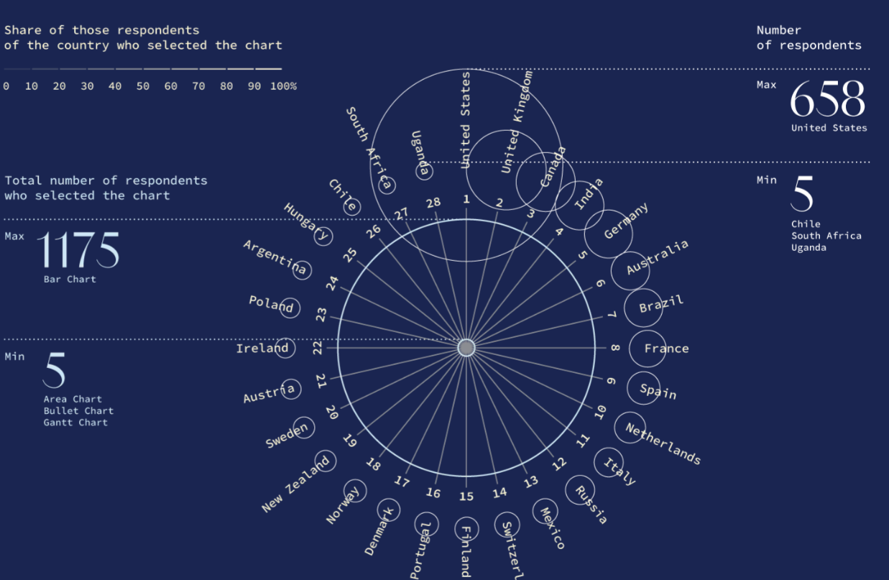
Most used visualisations
Nadia Andrianova – state of the data visualisation industry survey 2022
Notes:
Explain the context of SOTI survey ‘22 https://www.datavisualizationsociety.org/survey
This is an interactive visual – show + share the link http://designing.numbers.tilda.ws/charts_we_create_en with the class and give them time to explore and discuss what they see afterwards
Prompt questions – how easy did you find the visual to navigate | how does the visual work/ what were the interactive features you liked? were there any surprises in the most and least used chart types? did you recognise all the visual types listed? which ones have you (the class) used in the last 12 months? (this could also be a poll in Webex)

Slide 5


What chart should I use to…?
Hands-on exercise
Work in small groups
Task: 1.3.0_task_penguins
15 minutes to identify your chart types
Notes:
Open and explain the task. Learners have

Slide 6
Include multiple visual elements that are designed to complement
Feature controls which enable drilling
Are designed with an audience in mind
Show real time or near real time data
Aggregate data from different systems
Enable goal tracking (e.g., KPIs)
Are customisable and shareable
Dashboards are different because they:
Notes:
class discussion –ask the learners first for their list (gather on the class whiteboard)

Slide 7
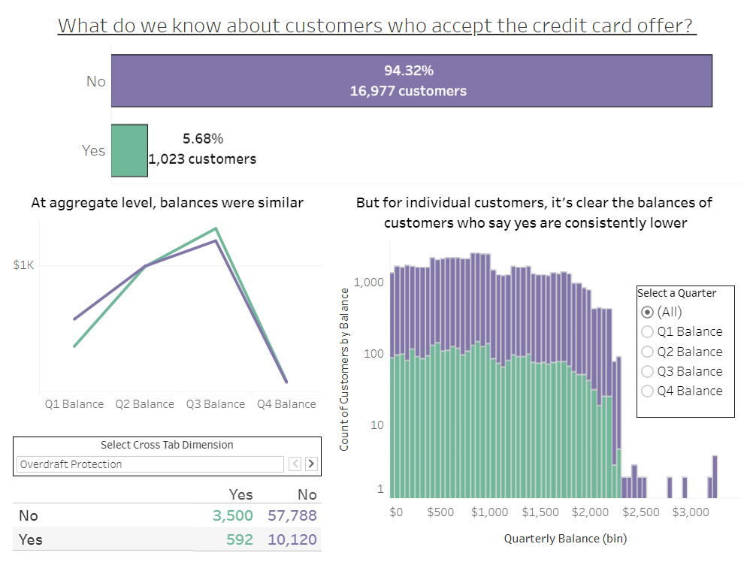
Dashboards require:
Respect for small screen real estate
White space
Control
Accessibility
Clarity
Text that explains

Slide 8
Connect to multiple data sources and data source types
Model relationships between data sources and tables
Reshape, enhance, and filter data
Configure visual elements (charts and tables) to represent the data
Connect visual elements interactively
Publish and share with others
Make data-driven decisions
BI software allows you to:
Notes:
class discussion –ask the learners first for their list (gather on the class whiteboard)

Slide 9
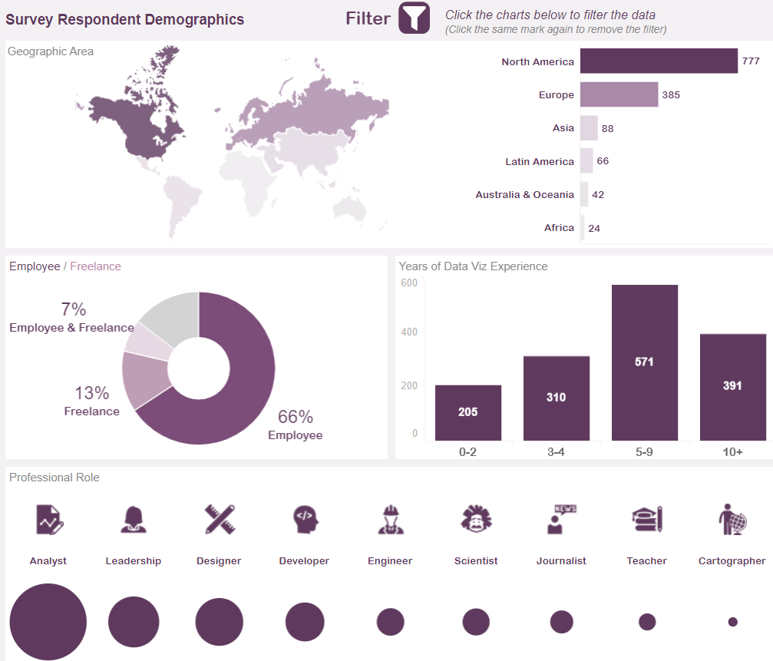
Most used BI tools
Rachel E Cinelli – state of the data visualisation industry survey 2022
Notes:
Explain the context of SOTI survey ‘22 https://www.datavisualizationsociety.org/survey
This is an interactive visual – show + share the link https://public.tableau.com/app/profile/rachelcinelli/viz/DVSSurveyDataVisualizationTools/DataVizToolsSurvey with the class and give them time to explore and discuss what they see afterwards
Prompt questions – how easy did you find the visual to navigate | how does the visual work/ what were the interactive features you liked?
were there any surprises in the most and least used BI tools? did you recognise all the tools listed? which ones are in use in your organisations? (this could also be a poll in Webex)

Slide 10
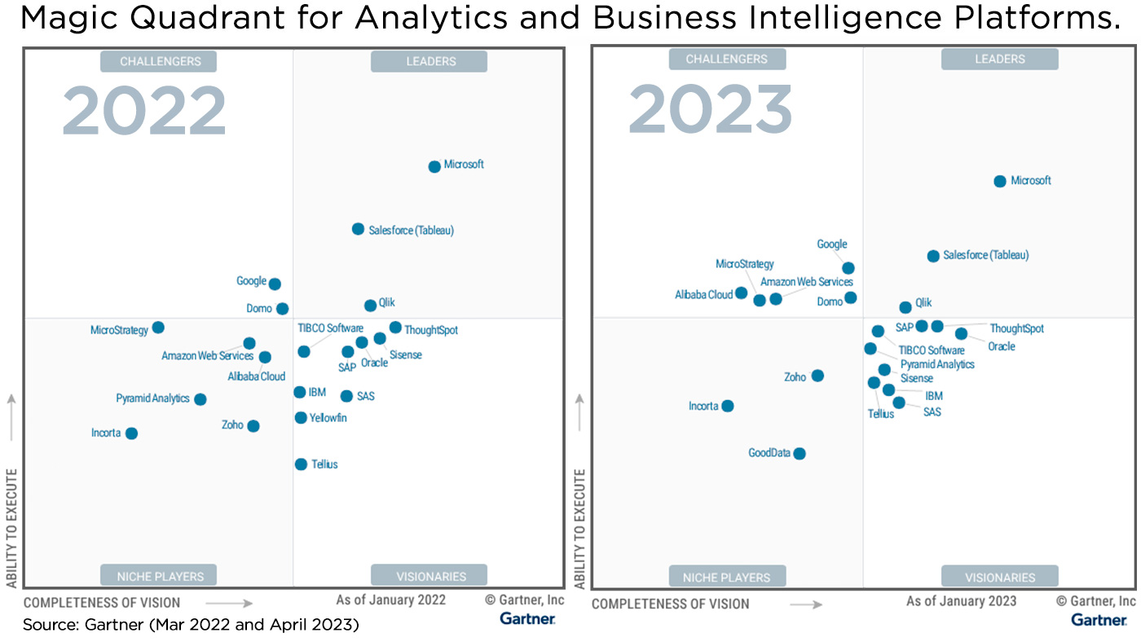
Cloud rising
Notes:
explain the context of the gartner magic quadrant and what it means to the industry.
discussion points for class : who do we see falling and rising in the leaders quadrant? why do we think that is? whats happening to the cloud providers? can you spot AWS ? what do you think has changed the position of AWS in the prev 12 months?

Slide 11


What visual style tells a good story?
Hands-on exercise
Work in small groups
Task: 1.3.1_task_diversityintech
15 minutes to review and prepare your talk back

Slide 12






deliberate use of complementary colours that are accessible
Visual best practices
adjust the size of plots, points and text to make things readable
ensure that what you design meets the needs of your audience (by asking them)
avoid suggesting connections that aren’t intended
use narrative to explain whats going on
declutter everything you build
Notes:
class discussion –ask the learners first for their list (gather on the class whiteboard)

Slide 13

Practise decluttering
Hands-on exercise
Work in small groups
Task_1.3.2_decluttering
10 minutes to identify decluttering steps

Slide 14
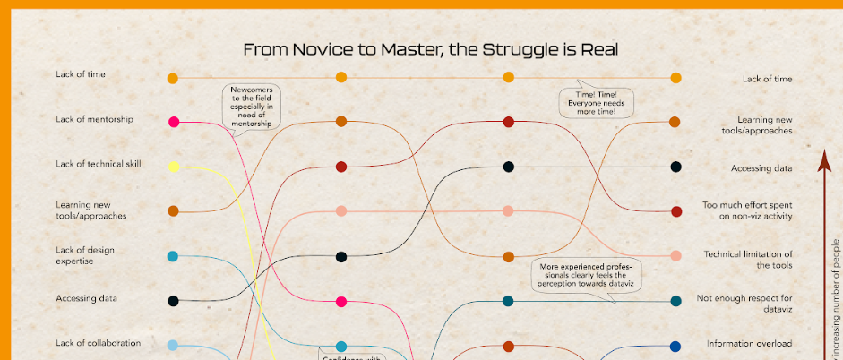
Your priorities
Arielle Khan – State of the data visualisation industry survey 2022
Learn techniques, not software
Map the end-to-end data journey
Work on requirements, not tasks
Build a portfolio
Refresh the questions, the data and your designs regularly
Notes:
Explain the context of SOTI survey ‘22 https://www.datavisualizationsociety.org/survey
This is an interactive visual – show/ explain + share the link https://drive.google.com/file/d/1aj397NltC1V9hDz5WHB6ECp1RLgqKlQJ/view with the class and give them time to explore and discuss what they see afterwards
Prompt questions – how easy did you find the visual to navigate | how does the visual work/ what were the interactive features you liked?
What about your experience? What have been the main challenges thus far in your journey to learn data visualisation and analytical tools/ techniques? Have any of the biggest challenges dropped down the pain point list? (this could also be a poll in Webex)

